Slide 1

SPORTS FACILITY AND TOURNAMENT MANAGEMENT
TEAM - 04
TEAM MEMBERS :
KISHORE R — 24BCS140 — LEAD
NAGUL JAVIN P — 24BCS179
VASANTH S — 24BCS304

Slide 2
Key Problems Addressed
PROBLEM STATEMENT
Lack of a centralized platform for managing sports activities.
Difficulty in managing tournament proposals and approvals.
Difficulty in managing separate team registration processes for internal and external students.”Difficulty in tracking facility availability and bookings.
Manual management of sports equipment issue and return.
Challenges in maintaining match schedules and scores.
Difficulty in providing updated tournament results and schedules to users.
Need for role-based access to ensure each actor can perform only their permitted activities.
Managing sports activities through separate and manual processes
makes it difficult to coordinate tournament proposals, team registrations, facility bookings, equipment management, match scheduling, scores, and results.
A centralized web-based system is therefore required to streamline these activities, provide role-based access, maintain accurate records, and make tournament information easily accessible to students and other stakeholders.

Slide 3
MODULES
No. | Module | Main Purpose
1 | User Authentication & Role-Based Access | Login and control access according to user role
2 | Sports Facility Management & Booking | Allow PE manage the facilities and students to book sports facilities
3 | Tournament Proposal & Approval | Submit, review, forward, and approve tournament proposals
4 | Team Registration & Approval | Register teams and process team approvals
5 | Tournament Management & Match Scheduling | Manage approved tournaments and schedule matches
6 | Match Result Management | Record scores, results, standings, and awards
7 | Equipment Management | Request, issue, return, and maintain equipment inventory

Slide 4
SPRINT 1:
Sprint 1 Goal
“To establish the core management and approval foundation of the Sports Facility and Tournament Management System by implementing secure user authentication, role-based access, sports facility management, and tournament proposal submission and approval.”
Sprint 1 Outcome
“Sprint 1 establishes secure role-based access and the basic administrative workflow, enabling authorized users to manage sports facilities and allowing coaches to submit tournament proposals for review and approval by the responsible authorities.”

Slide 5
Sprint 1 Backlog
Backlog Item | Description | Primary Actor | Story Points
1. User Authentication & Role-Based Access | Users authenticate into the system and receive access according to their assigned role. | All registered users | 5
2. Sports Facility Management | Manage sports facility information, including adding, updating, and deactivating facilities. | PE | 8
3. Tournament Proposal Submission | Coaches create and submit tournament proposals through the system. | Coach | 5
4. Tournament Proposal Approval | PE reviews proposals and approves or rejects them. | PE | 5
 |  | AVERAGE | 5.75

Slide 6
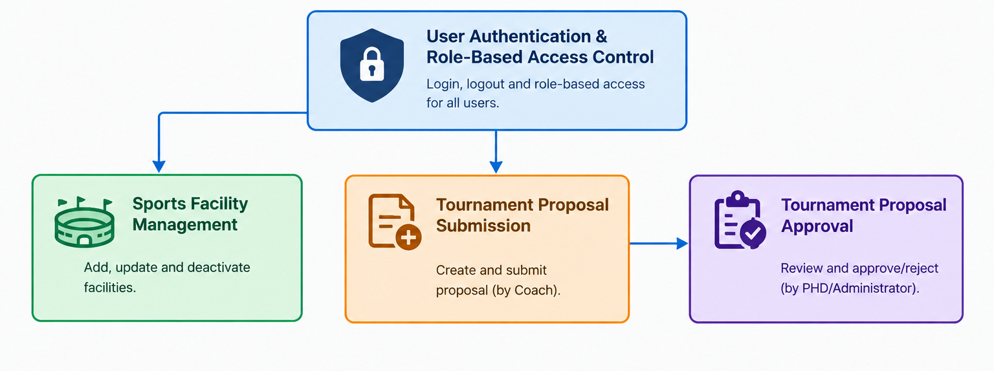
Connection Explanation
User Authentication & Role-Based Access → Sports Facility Management
Determines which users can manage sports facilities.
User Authentication & Role-Based Access → Tournament Proposal Submission
Ensures that only an authenticated Coach can submit a proposal.
Tournament Proposal Submission → Tournament Proposal Approval
A submitted proposal moves to the approval process.
Sports Coordinator acts as the intermediate role in the proposal workflow by
checking and forwarding the proposal to PE.

Slide 7
Functional Requirements
ID | Functional Requirement
FR-1.1 | The system shall allow registered users to log in using valid credentials.
FR-1.2 | The system shall validate the user's username/email and password.
FR-1.3 | The system shall identify the user's assigned role after successful login.
FR-1.4 | The system shall provide access to functions based on the user's role.
FR-1.5 | The system shall restrict unauthorized users from accessing restricted modules.
FR-1.6 | The system shall allow authenticated users to log out securely.
FR-1.7 | The system shall maintain the user's authentication session until logout or session expiry.
ID | Functional Requirement
FR-2.1 | The system shall allow the PE/Administrator to add a sports facility.
FR-2.2 | The system shall allow the PE/Administrator to enter facility details such as name, type, location, and status.
FR-2.3 | The system shall allow the PE/Administrator to view all registered facilities.
FR-2.4 | The system shall allow the PE/Administrator to update facility information.
FR-2.5 | The system shall allow the PE/Administrator to deactivate a facility.
FR-2.6 | The system shall maintain the current status of each facility.
FR-2.7 | The system shall prevent unauthorized users from modifying facility information.

Slide 8
ID | Functional Requirement
FR-3.1 | The system shall allow an authenticated Coach to create a tournament proposal.
FR-3.2 | The system shall allow the Coach to enter tournament details such as tournament name, sport, description, proposed dates, and facility/venue requirements.
FR-3.3 | The system shall validate mandatory proposal information before submission.
FR-3.4 | The system shall allow the Coach to submit the completed proposal.
FR-3.5 | The system shall store the submitted proposal in the database.
FR-3.6 | The system shall assign an initial status such as Submitted/Pending Approval to the proposal.
FR-3.7 | The system shall allow the Coach to view the status of their submitted proposal.

Slide 9
ID | Functional Requirement
FR-4.1 | The system shall allow the Sports Coordinator to view submitted tournament proposals.
FR-4.2 | The system shall allow the Sports Coordinator to check/review proposal details.
FR-4.3 | The system shall allow the Sports Coordinator to forward the proposal to the PE/Administrator.
FR-4.4 | The system shall update the proposal status when it is forwarded.
FR-4.5 | The system shall allow the PE/Administrator to view forwarded proposals.
FR-4.6 | The system shall allow the PE/Administrator to approve a proposal.
FR-4.7 | The system shall allow the PE/Administrator to reject a proposal.
FR-4.8 | The system shall record the approval/rejection decision and date.
FR-4.9 | The system shall update the proposal status to Approved or Rejected.
FR-4.10 | The system shall notify the Coach about the approval decision.

Slide 10
Non-Functional Requirements
Performance
The system should provide fast page loading and response times.
The system should support multiple users accessing it simultaneously.
Security
The system should securely store passwords and protect user data.
The system should enforce role-based access and prevent unauthorized access.
Reliability
The system should maintain accurate and consistent data.
The system should handle errors without losing submitted information.
Usability
The system should provide a simple and user-friendly interface.
The system should provide clear navigation, validation, and error messages.
Maintainability
The system should use a modular and well-structured design.
The system should be easy to maintain and extend with future modules.
Scalability
The system should support an increasing number of users and records.
The system should allow new modules and roles to be added easily.
Compatibility
The system should work on modern web browsers.
The system should be responsive on desktop, tablet, and mobile devices.
Data Integrity
The system should maintain accurate user, facility, and tournament proposal data.
The system should correctly maintain proposal status and approval decisions.

Slide 11
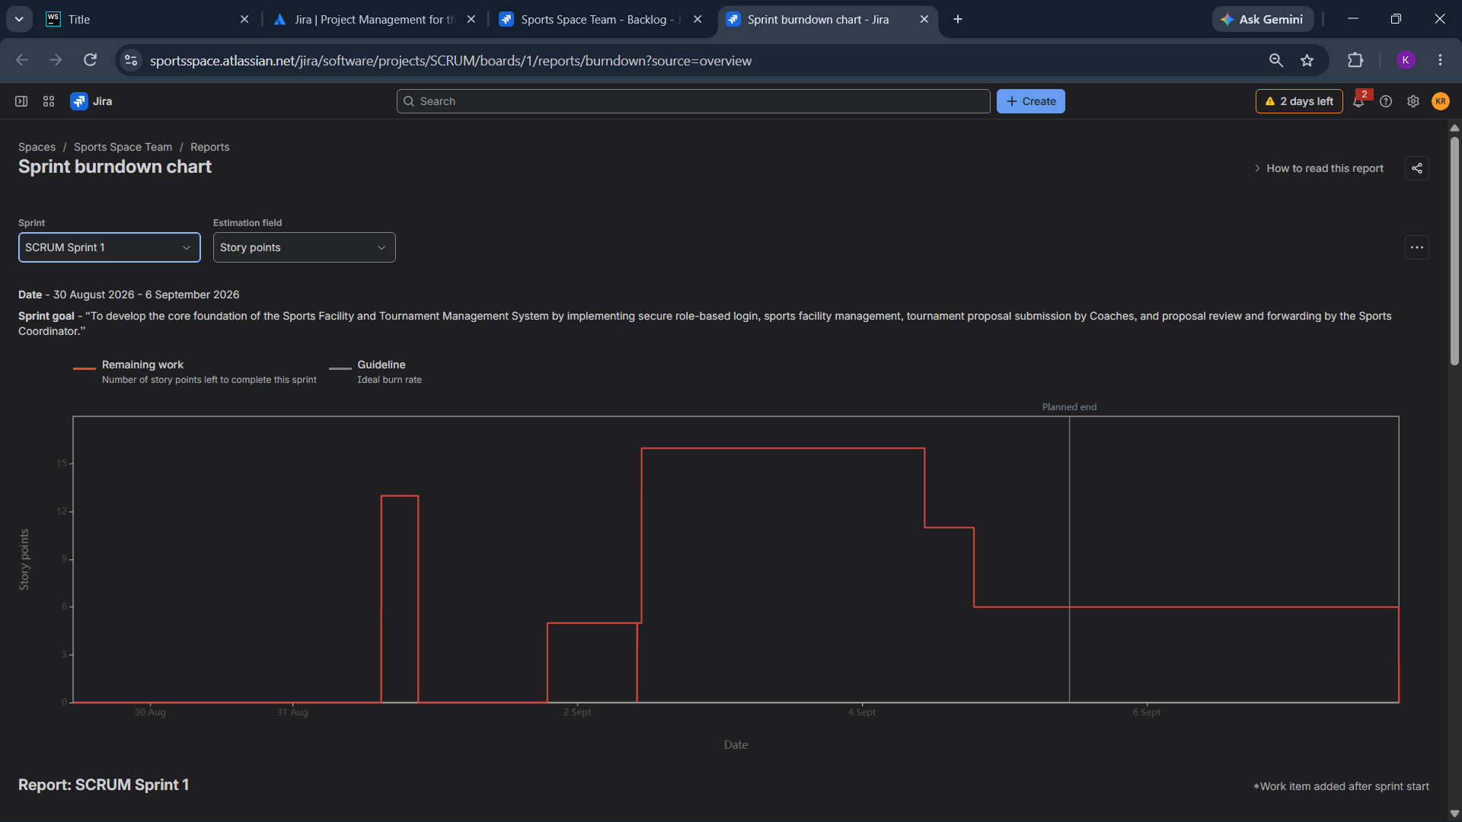

Slide 12
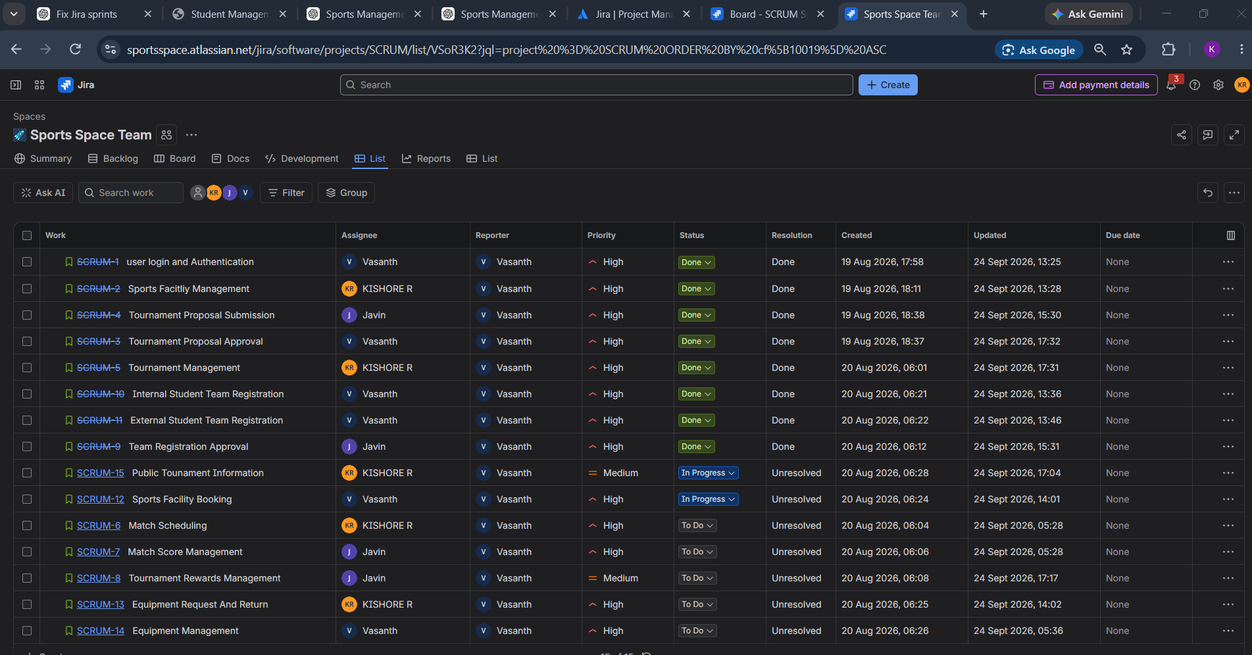

Slide 13
SPRINT 2:
Sprint 2 Goal
“To implement the core tournament participation workflow by enabling approved tournament management, separate registration processes for Internal and External Students, and team registration approval.”
Sprint 2 Outcome
“Sprint 2 establishes the tournament participation workflow, allowing authorized users to manage approved tournaments, Internal and External Students to register for tournaments, and submitted team registrations to be reviewed, approved, or rejected by authorized users.”

Slide 14
Sprint 2 Backlog
Backlog Item | Description | Story Points
Tournament Management | Manage approved tournaments, including tournament details, dates, venues, status, and participating teams. | 8
Internal Student Registration | Allow internal students to register for tournaments using their authenticated accounts. | 5
External Student Registration | Allow external students to register for tournaments through a tournament registration link. | 5
Team Registration Approval | Allow authorized users to review, approve, or reject submitted team registrations. | 5
 | Average | 5.75

Slide 15
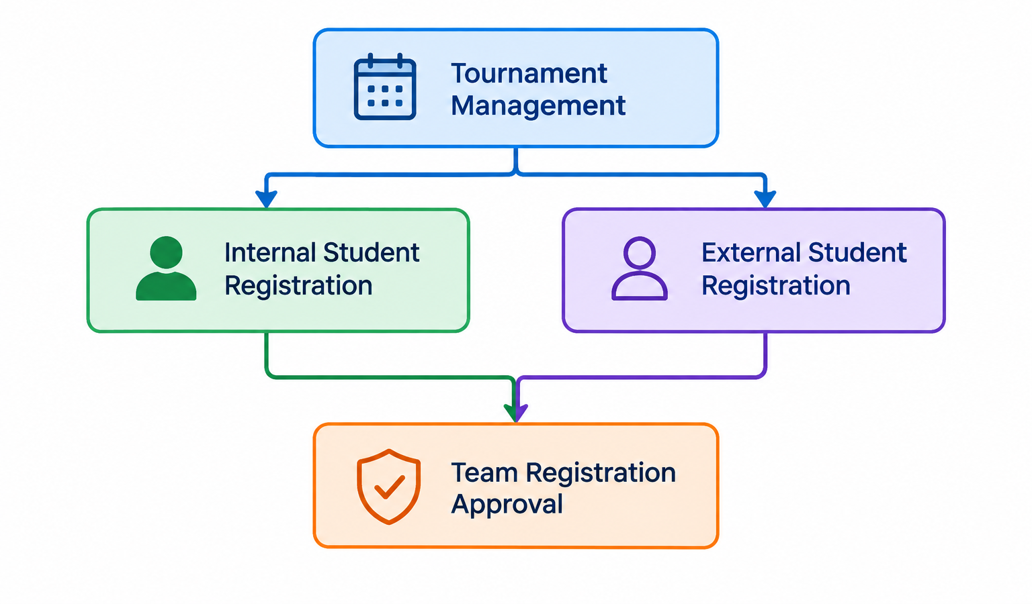
Modules Connected to Sprint 2
Module | Connected Module
Tournament Management | Internal Student Registration
Tournament Management | External Student Registration
Internal Student Registration | Team Registration Approval
External Student Registration | Team Registration Approval

Slide 16
Functional Requirements
ID | Functional Requirement
FR-5.1 | The system shall allow authorized users to manage approved tournaments.
FR-5.2 | The system shall allow users to view tournament details such as name, sport, date, venue, and status.
FR-5.3 | The system shall allow authorized users to update tournament information.
FR-5.4 | The system shall maintain the current status of each tournament.
FR-5.5 | The system shall allow participating teams to be associated with an approved tournament.
ID | Functional Requirement
FR-6.1 | The system shall allow authenticated Internal Students to register for a tournament.
FR-6.2 | The system shall retrieve and validate the student's registered details before registration.
FR-6.3 | The system shall prevent duplicate registration for the same tournament.
FR-6.4 | The system shall store the student's registration details in the database.
FR-6.5 | The system shall allow the Internal Student to view their registration status.

Slide 17
Functional Requirements
ID | Functional Requirement
FR-7.1 | The system shall allow External Students to register for a tournament through the provided registration link.
FR-7.2 | The system shall collect required external student and team details.
FR-7.3 | The system shall validate the submitted registration information.
FR-7.4 | The system shall prevent duplicate registration where applicable.
FR-7.5 | The system shall store the external student's registration details in the database.
FR-7.6 | The system shall display the registration status after submission.
ID | Functional Requirement
FR-8.1 | The system shall allow authorized users to view submitted team registrations.
FR-8.2 | The system shall allow authorized users to check team and participant details.
FR-8.3 | The system shall allow authorized users to approve a submitted team registration.
FR-8.4 | The system shall allow authorized users to reject a submitted team registration.
FR-8.5 | The system shall record the approval or rejection decision and date.
FR-8.6 | The system shall update the team registration status accordingly.
FR-8.7 | The system shall notify the relevant team representative about the approval or rejection decision.

Slide 18
Non-Functional Requirements
Category | Non-Functional Requirements
Performance | The system should provide fast response times for tournament management and registration operations.
Security | The system should protect student, team, and tournament information from unauthorized access.
Reliability | The system should reliably process and store tournament and registration data without data loss.
Usability | The system should provide a simple, clear, and user-friendly interface for internal and external students and authorized users.
Data Integrity | The system should maintain accurate and consistent tournament, student, team, and approval information.
Scalability | The system should support an increasing number of tournaments, students, and team registrations.
Availability | The system should be available whenever users need to access tournament and registration services.
Maintainability | The system should use a modular structure so that future features and changes can be implemented easily.
Compatibility | The system should work correctly on modern web browsers and different screen sizes.

Slide 19
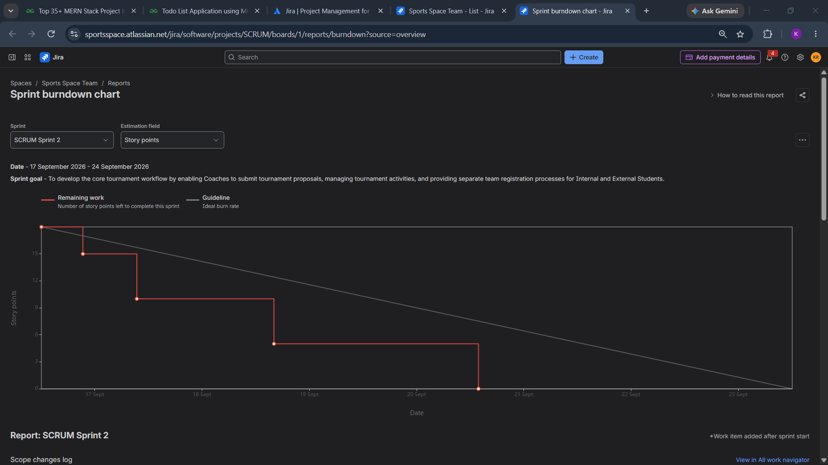

Slide 21
overall project flow
Sprint 1
Authentication & RBAC → Facility Management → Tournament Proposal Submission → Tournament Proposal Approval
Sprint 2
Approved Tournament Management → Internal/External Student Registration → Team Registration Approval
Sprint 3
Public Tournament Information → Facility Booking → Match Scheduling → Match Score Management
Sprint 4
Tournament Rewards Management → Equipment Management → Equipment Request & Return

Slide 22
SPRINT 3 plan
Week 1 — Sprint 3
Develop Public Tournament Information.
Display approved tournament details.
Display participating teams and tournament schedules.
Develop Sports Facility Booking.
Display available facilities and booking slots.
Implement booking and availability validation.
Week 2 — Sprint 3
Develop Match Scheduling.
Assign teams, dates, times, and venues to matches.
Develop Match Score Management.
Record and update match scores.
Display match results.
Integrate scheduling and scores with approved tournaments.
Perform Sprint 3 testing.
Backlog ID | Backlog Item | Main Plan
SCRUM-15 | Public Tournament Information | Display approved tournament details, participating teams, schedules, and results to users/public visitors.
SCRUM-12 | Sports Facility Booking | Allow authorized users to view facility availability and book available sports facilities.
SCRUM-6 | Match Scheduling | Create and manage match schedules with teams, dates, times, and venues.
SCRUM-7 | Match Score Management | Record, update, and display scores and match results.

Slide 23
SPRINT 4 Plan
Backlog ID | Backlog Item | Main Plan
SCRUM-8 | Tournament Rewards Management | Manage tournament winners, awards, and Man of the Match information.
SCRUM-13 | Equipment Request And Return | Allow users to request equipment and manage equipment issue and return processes.
SCRUM-14 | Equipment Management | Manage equipment details, inventory, availability, and status.
Week 3 — Sprint 4
Develop Tournament Rewards Management.
Record tournament winners and awards.
Manage Man of the Match information.
Develop Equipment Management.
Add, update, and view equipment information.
Track equipment availability and status.
Develop Equipment Request and Return.
Manage equipment requests, issue, and return.
Integrate equipment requests with equipment availability.
Perform Sprint 4 testing and integration.

Slide 24
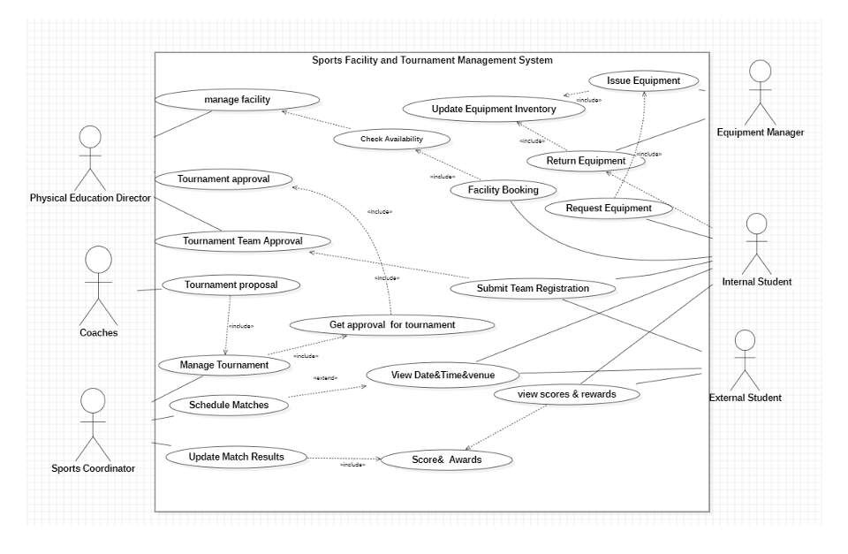
Use Case Diagram:

Slide 25
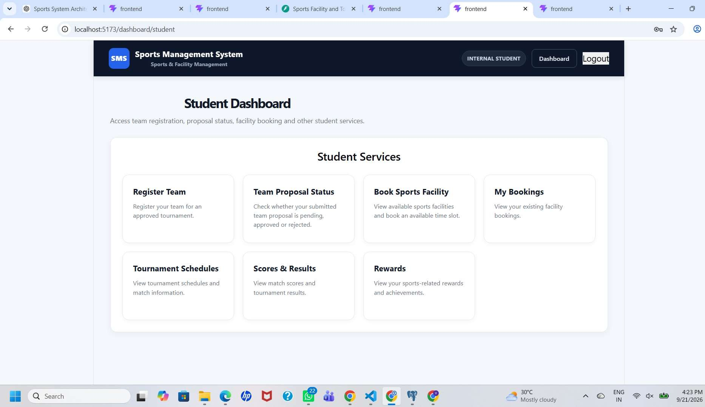

Slide 26
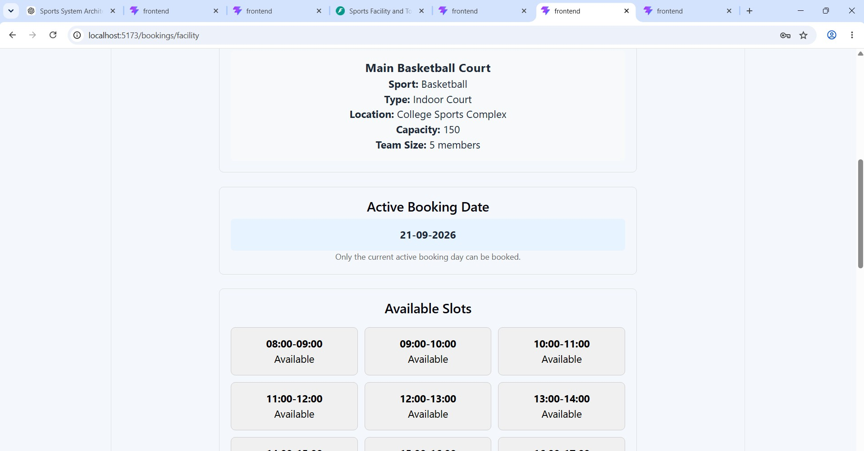

Slide 27
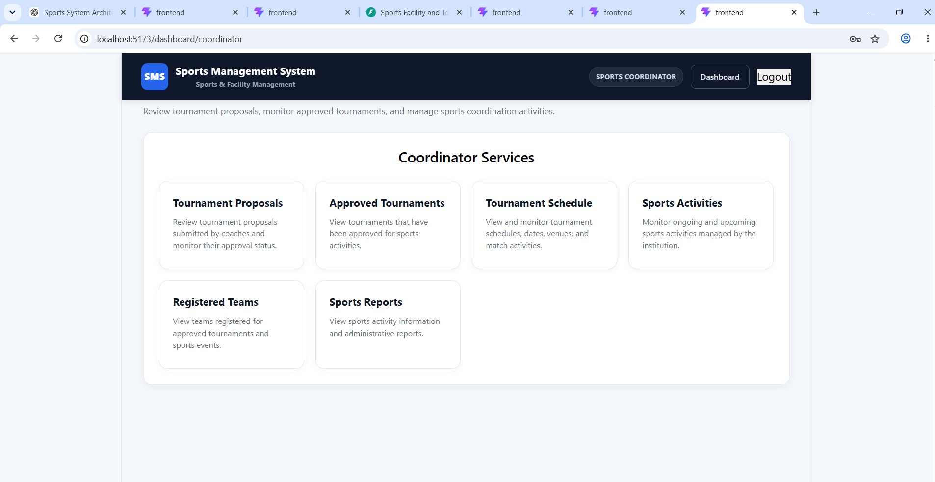

Slide 28
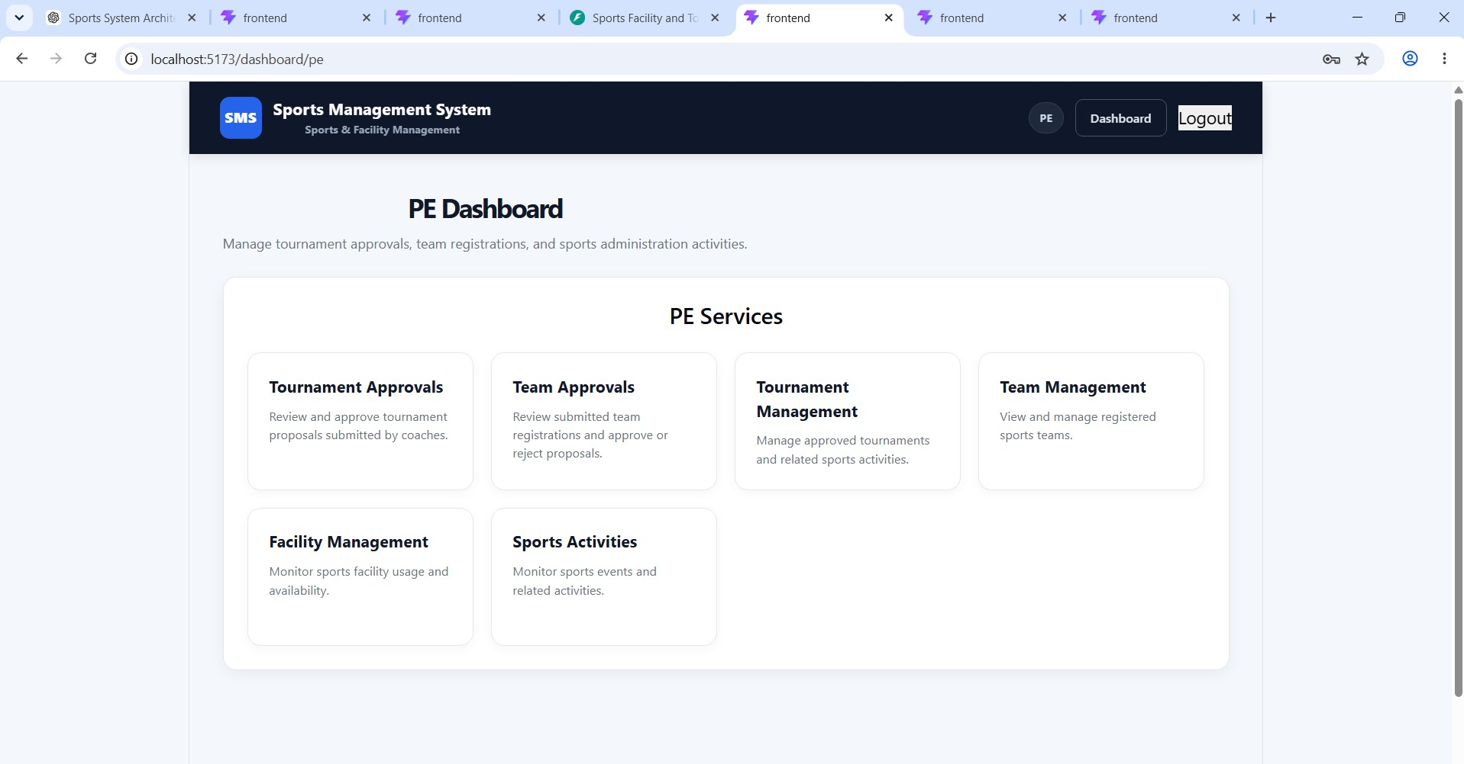

Slide 29
THANK YOU!!!!!

